Slide 1
API Authentication
Web Services and Applications
Andrew.Beatty@gmit.ie
Notes:
But not all APIs will want you to get data or interact with the data without you authenticating yourself.
Using API keys to inteteract with APIs that require authentication and OAuth exists
There are python packages that exist for a lot of the common APIs

Slide 2
Restricting access
A resource owner may want to restrict access to the resource.
May not want anyone to:
Change data
View sensitive data (your bank details)
May want to limit the number of times someone can make a request, especially if the request will take a lot of processing. E.g., searching twitter feeds.
Notes:
So why would they want to restrict access to the data?
The resource owner may not want you to change the data without sort of saying who you are. You don't want anyone necessarily adding books to that API which I made. If everyone started doing it or adding it, the data starts becoming useless.
Also, there's denial of service attacks.Somebody could start making tons and tons of books onto my API until my disk is full or I stop paying lots more money in in hosting.
They may also want to limit the amount of time someone can access a request, especially if the request does a lot of processing.
So one of the examples we're going to look at today is HTML to PDF where they want you to log in, have an API key just so they can limit the amount of times you access the data. Because if you do it too much, you could ccause their servers to keel over.
So that's another reason you may want to do authentication, Have a key is that the data isn't necessarily that sensitive. It might be free, but they want to limit the amount of times you can do stuff. Twitter does this as well. They can also leverage this that if you want to have more in the more access then you pay them. So it's not only just a stop denial of service attacks, it's also they can get more money out of you.
There's another reason which is you may want to create an application that third parties would use that other users would use to interact with their data and other accounts. And so you want them to log in with a username password, but you don't want to store their username password with the third account. So this is where Oauth comes in.

Slide 3
API Keys
API keys exist, and can be used to provide authorisation to access resources
The resource owner can generate a key can give it to a third party, to allow the third-party access to the resource.
Hotel key
In practice:
Get a key:
Apply for a key from the resource owner
Log in and generate a key
Include it in the request to access the resource
Put it in the URL (GET) as a parameter
Put it in the header as a attribute
Just like any other bit of data
Notes:
So the simplest way that AAPI can restrict access is API keys. I just want you to know they exist.Sometimes you have to go digging around to find out how you get an API key of something you have credentials for. Look at the documentations you need to get it.It's a big huge long string that is quite unique.
So usually you can generate the API key, give it to a third party or then they have access to the resource, so you can put it onto one of your applications and then you have access.It's kind of like a hotel key.
One thing is do not put your API keys on GitHub.There are people out in the Internet who are running programs which are scanning through GitHub the whole time looking for keys, looking for API keys and they look for them and then they can have access to the resource.So that takes away the points.So never put an API key, never push it in code onto GitHub.What you should do is make a configuration file which is just like in Python.You would have it as a dictionary object in another file that you import and then you can use that data.And you never push that dictionary file to GitHub.So make sure that your keys are never stored in something public like GitHub.
Private GitHub repository, Of course you could because you're in there anyway.But be careful with your API keys.
So in practice you apply for the key from resource owner, or you log in and and you generate it.There's loads of different ways.Some people, some organizations, you need to send them an e-mail.I've got some keys for a bank that I'm writing an application for that is interacting with bank accounts.So getting the keys off them is I have to log into a secure site, they need to send me a private message on that secure site.There's a whole pile of palaver to make sure that no other party gets the API keys, and I need to make sure that those API keys are only kept on my machine here, I'm not pushing them onto anywhere else.Then what you do is you include that API key in a request to make to the resource.
And there's two ways of doing this.One you can put into a a GET request.It's like any other parameter.This is kind of an old way of doing it, maybe less secure because it's in the URL.
The other way is you push it into a header and HTTP allows this with https://protocols that it will be encrypted so people won't be able to see it.The way you often do that is with the GET request you have seen with the URL you have auth equals and the token and that should be done with HTTPS.That would be quite secure.
response = requests.get(url, auth=(‘token’, apikey))

Slide 4
Demonstration 2 Github
We saw in the last lecture that GitHub has an API, and used it to get public information
We can use the API get private information and make commits to the repository
Setting => generation a API key
Use the key in requests
I have made a github account for this user: datarepresentationstudent
Key: b4ddb9e5603da11cd857b83bad6ea6eb1819b92d
More info
https://developer.github.com/v3/
https://developer.github.com/v3/guides/
requests.get(url, auth=('token',apiKey))
Notes:
https://html2pdf.app > Documentation > https://api.html2pdf.app/v1/generate?html=https://example.com&apiKey={your-api-key} > register > login
Dashboard> API keys > Show > Crtl+C
Run python my5htmltopdfdemo.py > right click my5document.pdf > copy path > paste into webbrowser . U get wikipedia page as pdf
Now one of the things, we shouldn't have the API key inside our files. We should not have it inside our files because if we do, people can web scrape through or not web scrape, they can scrape through all the files in GitHub.So if we put this into a file and it goes up to GitHub, somebody will get this key and that is the security hole.So we should really make a config file.
My5config,py, copy api into there
Go back to my5htmltopdfdemo.py
On gitignore, add: config.py, my5config.py
GitHub is an API as well. It allows you to get public information, so you can get information from any kind of repository, Any public repository you can get who follows.
You can get a whole pile of information on the GitHub documentation.This is how people can create scripts that will go through all GitHub, checking every single piece of code to see if there is API keys up there private repositories. You will need an API token to get that.
make a lab so you can see yourself how you can make a program that will do automatic commits.
So you get a key from GitHub as an example of what it might look like. And there's lots of information in developer.github.com.

Slide 5
A bit more on OAuth
OAuth1 and OAuth2
Lots of different use-cases
2 legged
Resource owner of a techy and can get the key from the authorisation server
3 legged
Resource owner is not a techy, so we need to write the code to get the key from the authorisation server.
This is beyond the scope of this course….. But worth a quick explanation
https://auth0.com/docs/api-auth/which-oauth-flow-to-use
Notes:
Everyone uses Oauth 2 at the moment. There's lots of different use cases for this.
The one we're mainly using is the 2 legged version where you just have you get a key and you store the key on some authorized server and that interacts with third party system.
The three legged one is where the person who's going to be using this is not so techy. So they want to log into a system and give you permission to interact with it.
It's beyond the scope of this course and there's documentation here on in Oauth that you can look at.I just want you to know it exists.
Places like Stripe also have something similar to this.If you want to put Stripe on your system, it downloads the code and users put their credit card numbers and details and that goes straight to Stripe and then they give you a token allowing you to use that credit card number, that credit card to make payments.And this means you do not store the credit card numbers on your own servers which is safer.It means you don't have to go through the level of security that stripe to storing people's credit cards.

Slide 6
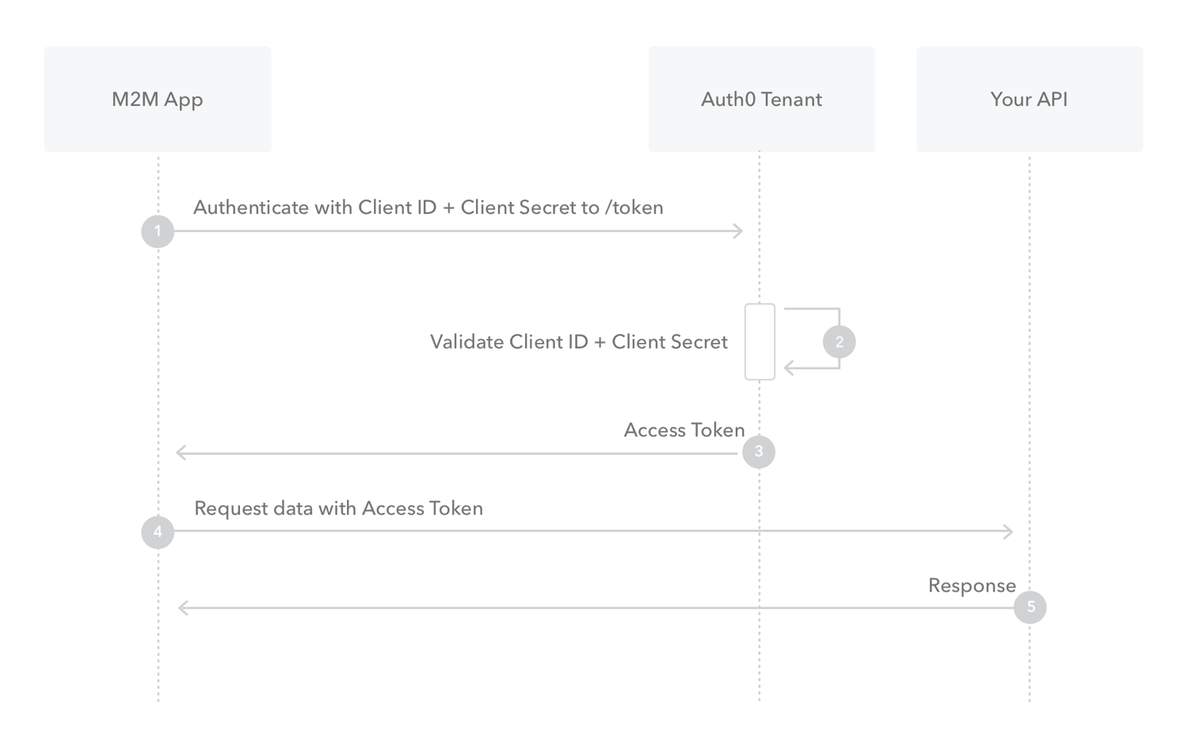
Notes:
This is kind of what the information looks like.
So you basically you get the token, the tenant will you get the token, then you request the access token and then you get the data back.

Slide 7
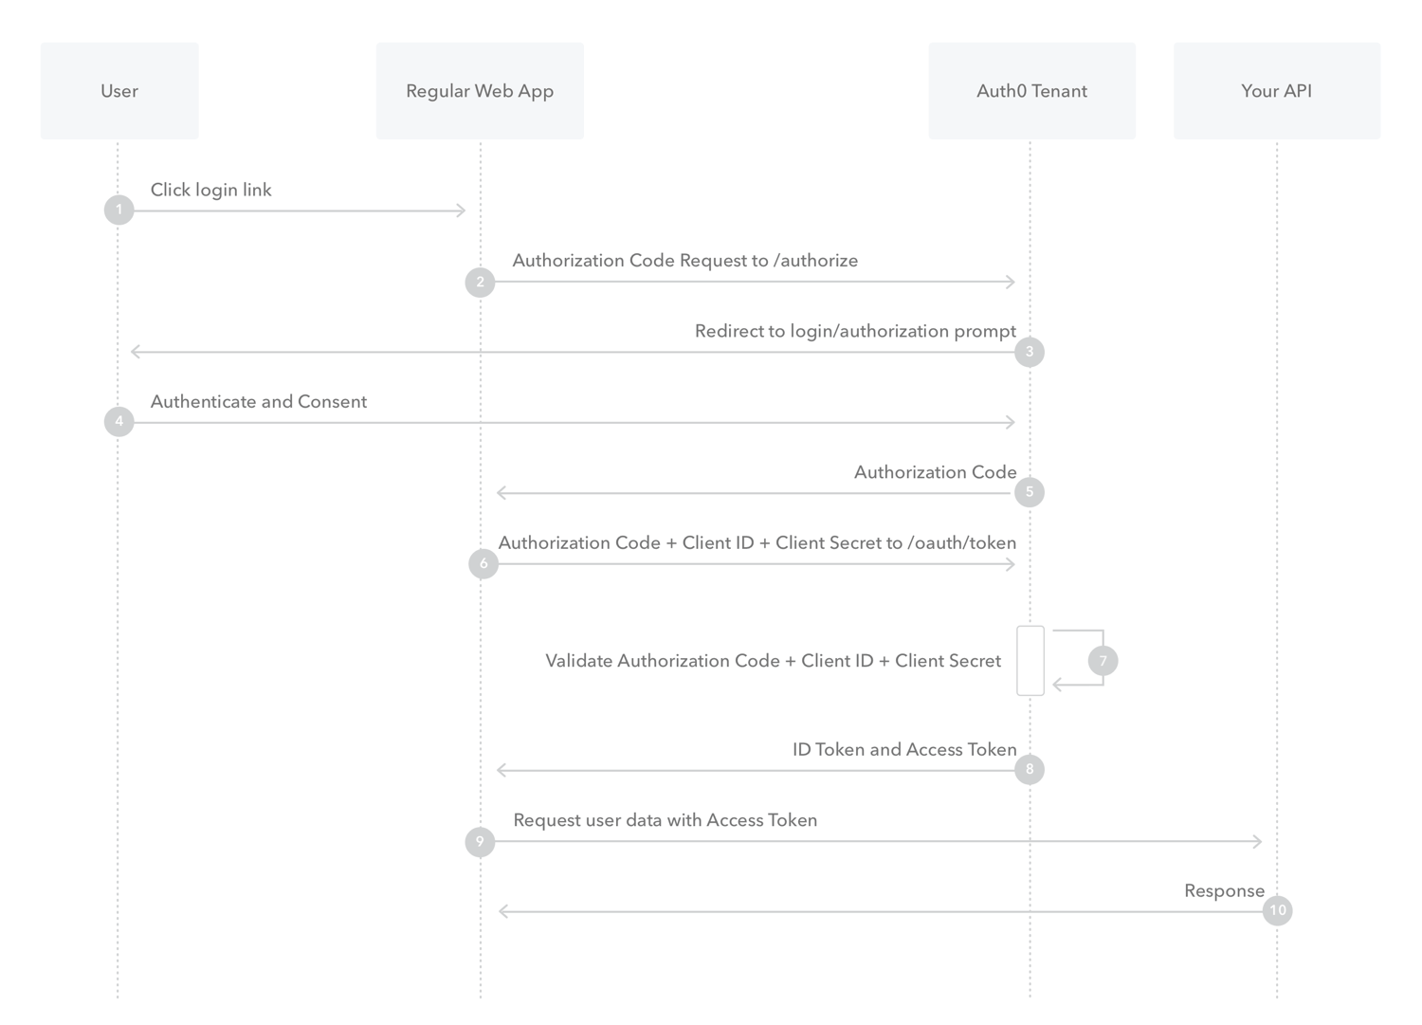
Notes:
And the three legged one is slightly more complicated.So the user will click on a login link that will send the information to ask the Oauth tenant to authorize itself.
They will send back a prompt for the user to put in their username and password.The user puts in their username and password straight to.That was it.
Stripe or GitHub or whatever it is.
So the username password goes straight to them, you don't see it, and then they will send you back an authorization code and then you can use that authorization token to get a token.
They will get the token, it does internal validation, send you back the token and then you can basically interact with the privilege resource.

Slide 8
Conclusion
You may need keys to access a resource
Log on the resource server
Get the key
Include it in the requests
Notes:
In conclusion, you need keys to access a resource a lot of the times.
So you need to either get the key from by logging into the resource GitHub or or Gmail or whatever it might be Twitter.
You get some key and then you put it into your request.

